Slide 1
GRASP Patterns
Dr. Ali Murat TİRYAKİ
Çanakkale Onsekiz Mart Üniversitesi
Bilgisayar Mühendisliği Bölümü

Slide 2
Responsibilities of an Object
Doing responsibilities of an object include:
  doing something itself, such as creating an object or doing a calculation
  initiating action in other objects
  controlling and coordinating activities in other objects
Knowing responsibilities of an object include:
  knowing about private encapsulated data
  knowing about related objects
  knowing about things it can derive or calculate

Slide 3
GRASP: A Learning Aid for OO Design with Responsibilities

Slide 4
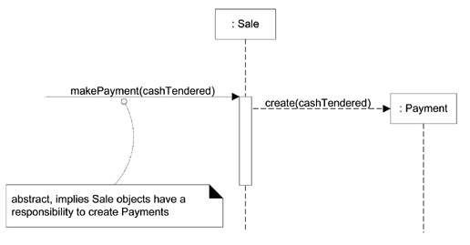
Responsibilities and methods are related

Slide 5
Creator
Name: | Creator
Problem: | Who creates an A?
Solution: (this can be viewed as advice) | Assign class B the responsibility to create an instance of class A if one of these is true (the more the better): B "contains" or compositely aggregates A. B records A. B closely uses A. B has the initializing data for A.

Slide 6
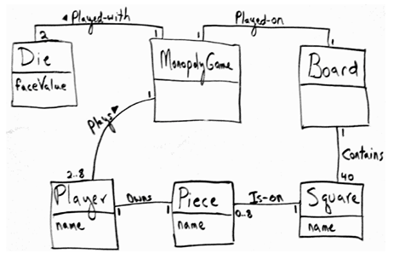
Monopoly iteration-1 domain model

Slide 7
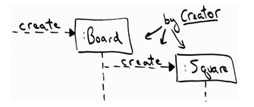
Applying the Creator pattern in a dynamic model

Slide 8
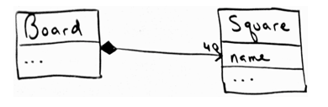
Class Diagram for Square

Slide 9
Information Expert
Name: | Information Expert
Problem: | What is a basic principle by which to assign responsibilities to objects?
Solution: (advice) | Assign a responsibility to the class that has the information needed to fulfill it.

Slide 10
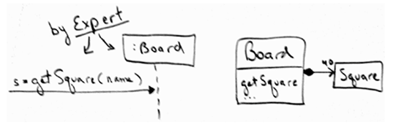
Applying Expert

Slide 11
Low Coupling
Name: | Low Coupling
Problem: | How to reduce the impact of change?
Solution: (advice) | Assign responsibilities so that (unnecessary) coupling remains low. Use this principle to evaluate alternatives.

Slide 12
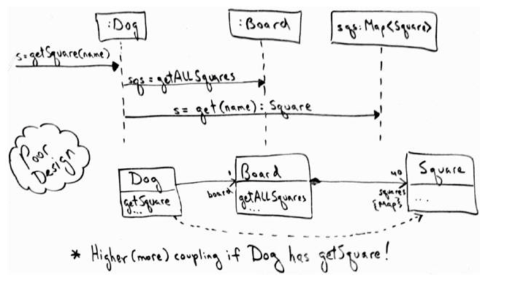
Evaluating the effect of coupling on this design

Slide 13
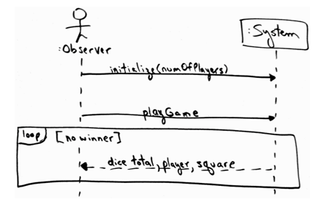
SSD for the Monopoly game

Slide 14
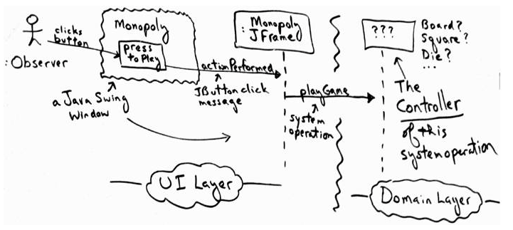
Who is the Controller for the playGame system operation?

Slide 15
Controller
Name: | Controller
Problem: | What first object beyond the UI layer receives and coordinates ("controls") a system operation?
Solution: (advice) | Assign the responsibility to an object representing one of these choices: Represents the overall "system," a "root object," a device that the software is running within, or a major subsystem (these are all variations of a facade controller). Represents a use case scenario within which the system operation occurs (a use case or session controller)

Slide 16
Option 1: Represents the overall "system," or a "root object"such as an object called MonopolyGame.
Option 1: Represents a device that the software is running within this option appertains to specialized hardware devices such as a phone or a bank cash machine (e.g., software class Phone or BankCashMachine); it doesn't apply in this case.
Option 2: Represents the use case or session. The use case that the playGame system operation occurs within is called Play Monopoly Game. Thus, a software class such as PlayMonopolyGameHandler (appending "…Handler" or "…Session" is an idiom in OO design when this version is used).

Slide 17
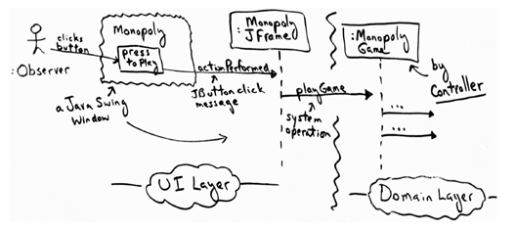
Applying the Controller pattern using MonopolyGame

Slide 18
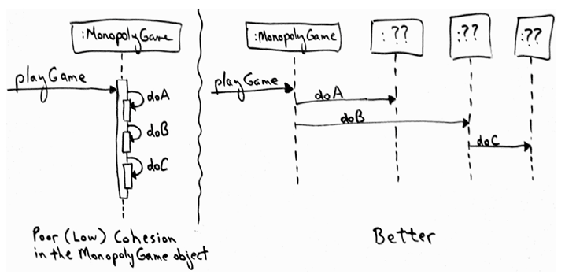
Contrasting the level of cohesion in different designs

Slide 19
High Cohesion
Name: | High Cohesion
Problem: | How to keep objects focused, understandable, and manageable, and as a side effect, support Low Coupling?
Solution: (advice) | Assign responsibilities so that cohesion remains high. Use this to evaluate alternatives.

Slide 20
Nine GRASP patterns
Creator | Controller | Pure Fabrication
Information Expert | High Cohesion | Indirection
Low Coupling | Polymorphism | Protected Variations

Slide 21
Creator

Slide 22
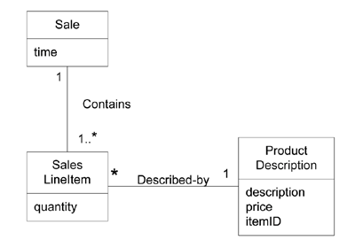
Example

Slide 23
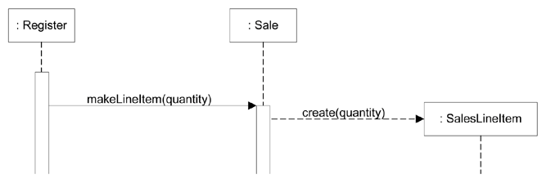
Creating a SalesLineItem

Slide 24
Creator
Benefits
  Low coupling is supported,
Related Patterns or Principles
  Low Coupling
  Concrete Factory and Abstract Factory

Slide 25
Information Expert (or Expert)

Slide 26
Example
In the NextGEN POS application, some class needs to know the grand total of a sale.
Who should be responsible for knowing the grand total of a sale?

Slide 27
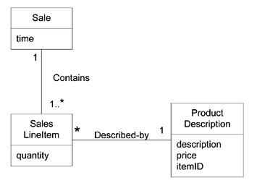
Associations of Sale

Slide 28
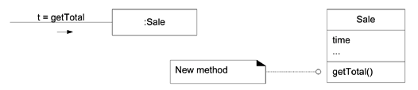
Partial interaction and class diagrams

Slide 29
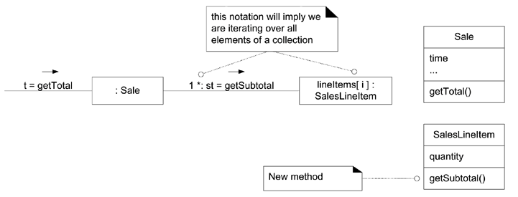
Calculating the Sale total

Slide 30
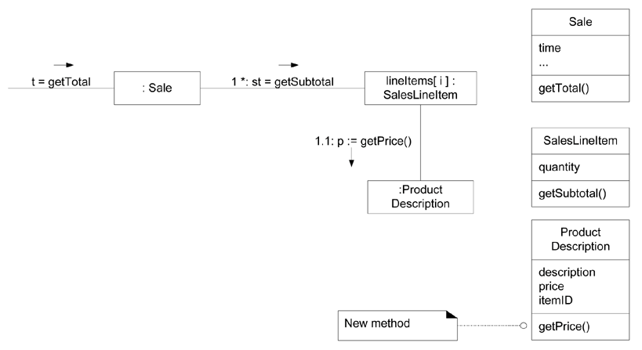
Calculating the Sale total

Slide 31
Design Class | Responsibility
Sale | knows sale total
SalesLineItem | knows line item subtotal
ProductDescription | knows product price

Slide 32
Benefits
  Information encapsulation is maintained since objects use their own information to fulfill tasks.
  Behavior is distributed across the classes that have the required information,
Related Patterns or Principles
  Low Coupling
  High Cohesion

Slide 33
Low Coupling

Slide 34

Example
Consider the following partial class diagram from a NextGen case study:

Slide 35
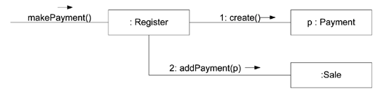
Register creates Payment

Slide 36
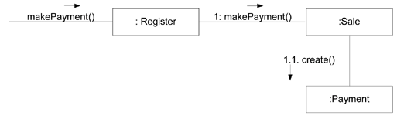
Sale creates Payment

Slide 37
Benefits
  not affected by changes in other components
  simple to understand in isolation
  convenient to reuse
Related Patterns
  Protected Variation

Slide 38
Controller

Slide 39
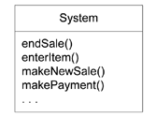
Example

Slide 40
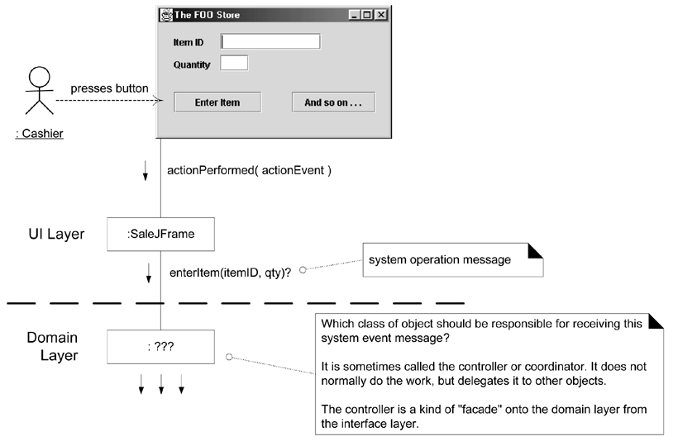
What object should be the Controller for enterItem?

Slide 41
Who should be the controller for system events such as enterItem and endSale?
By the Controller pattern, here are some choices:
Represents the overall "system," "root object," device, or subsystem. | Register, POSSystem
Represents a receiver or handler of all system events of a use case scenario. | ProcessSaleHandler, ProcessSaleSession

Slide 42
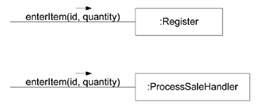
Controller choices

Slide 43
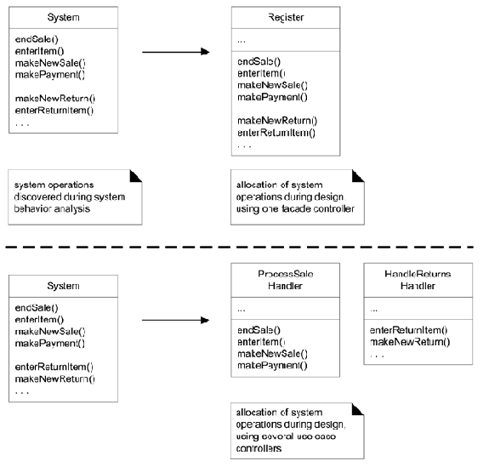

Slide 44
Bloated Controllers
There is only a single controller class receiving all system events in the system, and there are many of them. This sometimes happens if a facade controller is chosen.
The controller itself performs many of the tasks necessary to fulfill the system event, without delegating the work. This usually involves a violation of Information Expert and High Cohesion.
A controller has many attributes, and it maintains significant information about the system or domain, which should have been distributed to other objects, or it duplicates information found elsewhere.

Slide 45
Use case Controllers instead of Facade Controllers
Use case controllers
MakeReservationHandler
ManageSchedulesHandler
ManageFaresHandler

Slide 46
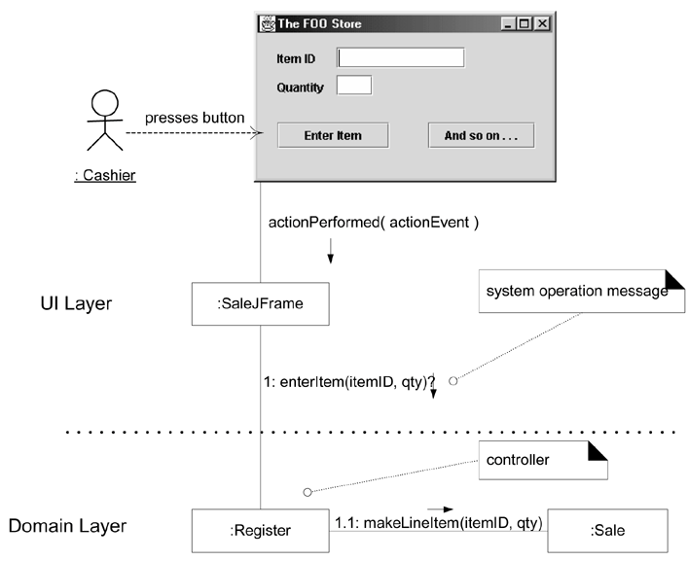
Desirable coupling of UI layer to domain layer

Slide 47
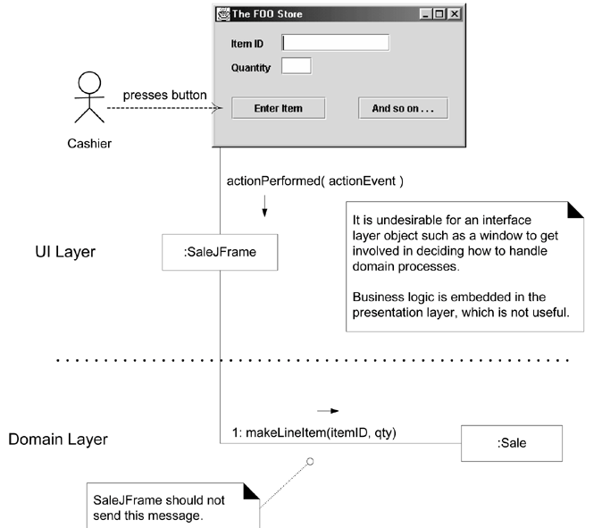
Less desirable coupling of interface layer to domain layer

Slide 48
High Cohesion

Slide 49
Problems of Bad Cohasion
hard to comprehend
hard to reuse
hard to maintain
delicate; constantly affected by change

Slide 50
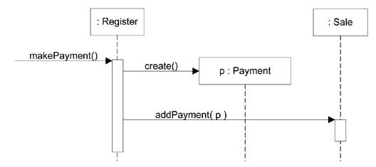
Example

Slide 51
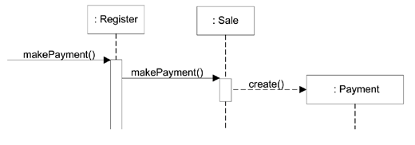
Sale creates Payment

Slide 52
Benefits
Clarity and ease of comprehension of the design is increased.
Maintenance and enhancements are simplified.
Low coupling is often supported.
Reuse of fine-grained, highly related functionality is increased because a cohesive class can be used for a very specific purpose.

